Slide 1
Embedded Computing Systems EEME30001
Week 7:
Timers
(Architecture, Functions, and Configuration)

Slide 2
Introduction to Timers
  A timer in a microprocessor is a hardware-based peripheral used to measure time intervals or to generate precise delays. Timers are an essential feature in embedded systems and microcontrollers, providing the ability to control time-based functions and events.
What is a Timer in a Microprocessor?

Slide 3
Introduction to Timers
Timers typically operate by counting clock cycles from a specified source, which can be the system clock or an external signal. Once a predefined number of cycles is reached, the timer can trigger an event, such as generating an interrupt or toggling a hardware pin. This functionality allows microprocessors to:
Measure Time Intervals: Timers can accurately measure how much time has passed, which is crucial for tasks like calculating elapsed time or monitoring system performance.
Generate Delays: By counting to a specific value, timers can be used to delay program execution for a specific duration.
Event Scheduling: Timers are used to trigger periodic tasks in real-time systems, such as updating sensor values, refreshing displays, or controlling motors at fixed intervals.
Pulse Width Modulation (PWM): Timers are often used to generate PWM signals for motor control, LED dimming, or other tasks that require precise control over signal timing.

Slide 4
General Overview of CPU Timers
The TMS320F2837xD microcontroller includes six 32-bit CPU timers:
CPU1: TIMER0, TIMER1, TIMER2
CPU2: TIMER0, TIMER1, TIMER2
These timers provide precise time control for applications like general-purpose timing and real-time operating systems.

Slide 5
General Overview of CPU Timers
Each timer includes a 32-bit count-down register.
An interrupt is generated when the counter reaches zero.
All CPU timers are identical, with programmable periods and a 16-bit prescaler.
The timer automatically reloads the 32-bit period value after each cycle.

Slide 6
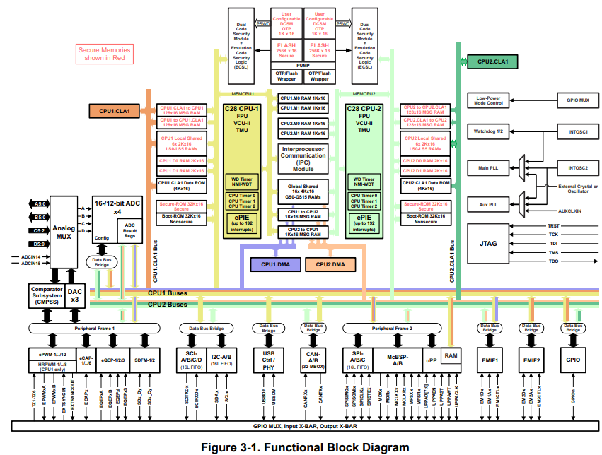
C28379d Functional Block Diagram
Notes:
https://www.ti.com/lit/ds/symlink/tms320f28379d.pdf?ts=1727763135096&ref_url=https%253A%252F%252Fwww.ti.com%252Fproduct%252FTMS320F28379D

Slide 7
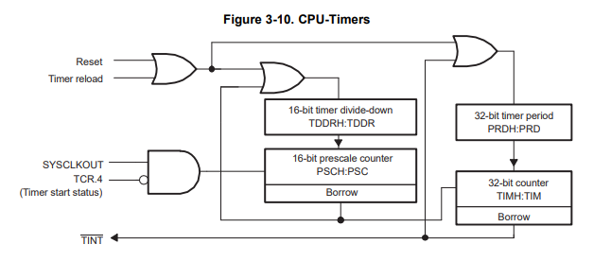
CPU Timers
The CPU timers are identical 32-bit timers with presettable periods and 16-bit clock prescaling.
Each timer has a 32-bit count-down register that generates an interrupt when the counter reaches zero.
The counter decrements at the CPU clock speed divided by the prescale value setting. When the counter reaches zero, it is automatically reloaded with a 32-bit period value.

Slide 8
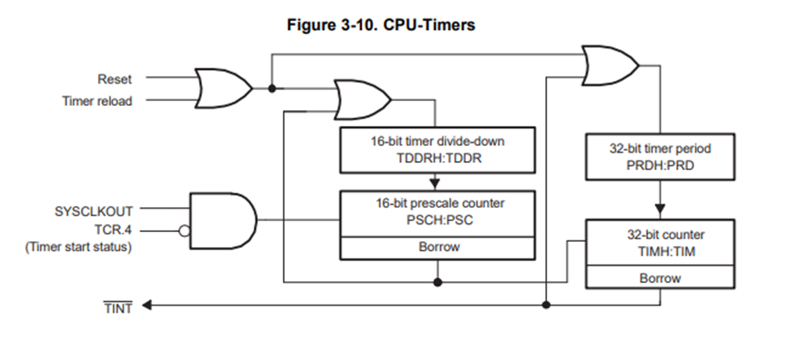
Presettable and Prescaling
When we refer to a timer as "presettable," it means that the timer can be initialised with a specific value from which it will start counting. This initial value is set in the timer's period register. In the context of the TMS320F28379D microcontroller, the period register (PRDH) holds the value that the timer will count down from. This allows the timer to generate an interrupt or perform an action after a precise interval, defined by the preset value

Slide 9
Presettable and Prescaling
Presettable:
When we refer to a timer as "presettable," it means that the timer can be initialised with a specific value from which it will start counting. This initial value is set in the timer's period register. In the context of the TMS320F28379D microcontroller, the period register (PRDH) holds the value that the timer will count down from. This allows the timer to generate an interrupt or perform an action after a precise interval, defined by the preset value.
Example: If you set the period register to 0xFFFFFFFF, the timer will count down from this value to zero. Once it reaches zero, it will generate an interrupt or reset to the initial value and start counting down again.

Slide 10
Presettable and Prescaling
Prescaling:
Prescaling involves dividing the clock frequency that drives the timer by a specific value, which effectively slows down the timer's counting rate. This is controlled by the prescaler register.
By adjusting the prescaler, you can extend the timer's counting period without changing the preset value.
This is useful for applications that require longer time intervals than what the base clock rate would allow.
Example: If the system clock (SYSCLKOUT) runs at 100 MHz and you set the prescaler to 9, the timer will count at 100 MHz / (9 + 1) = 10 MHz.
This means the timer's counting interval is effectively increased by a factor of 10, allowing for longer periods without modifying the timer's preset value.

Slide 11
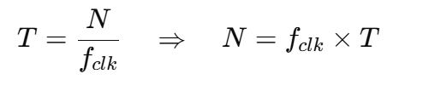

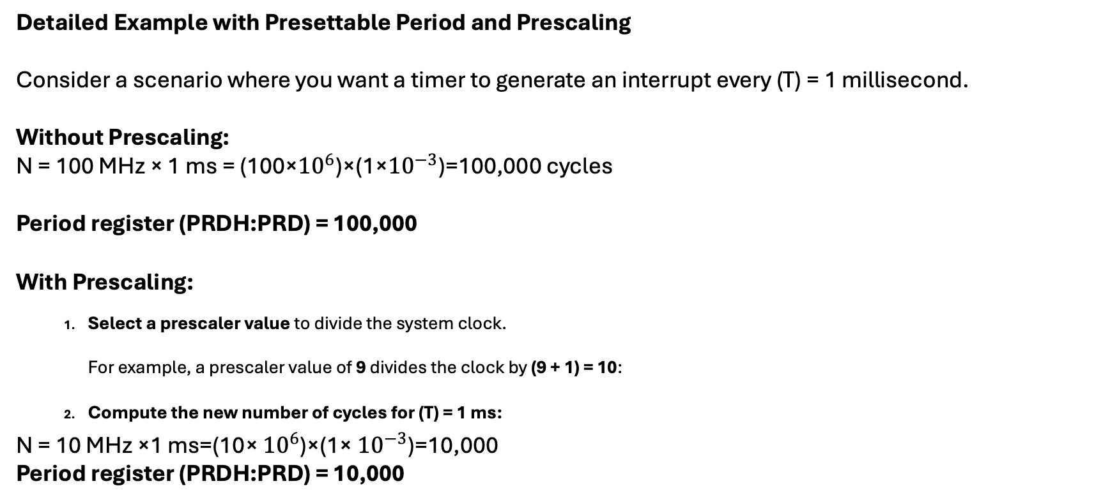
Detailed Example with Presettable and Prescaling
Detailed Example with Presettable Period and Prescaling
Consider a scenario where you want a timer to generate an interrupt every (T) = 1 millisecond.
Without Prescaling:
N = 100 MHz × 1 ms = (100×${10}^{6}$)×(1×${10}^{−3}$)=100,000 cycles
Period register (PRDH:PRD) = 100,000
With Prescaling:
  Select a prescaler value to divide the system clock.
  For example, a prescaler value of 9 divides the clock by (9 + 1) = 10:
  Compute the new number of cycles for (T) = 1 ms:
N = 10 MHz ×1 ms=(10× ${10}^{6}$)×(1× ${10}^{−3}$)=10,000
Period register (PRDH:PRD) = 10,000

Slide 12
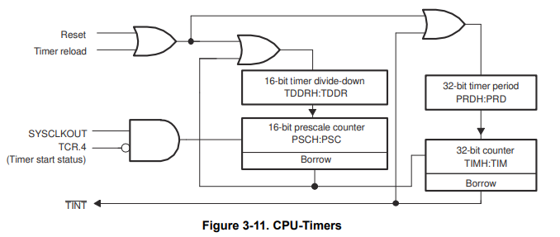
Clock Source for the timers (1/2)
Timer0 and Timer1:
CPU-Timer0 and CPU-Timer1
run off of SYSCLK
Timer2: normally runs off of SYSCLK, but can also use INTOSC1, INTOSC2, XTAL, and AUXPLLCLK.
TCR.4 = TSS bit. It enables or disables the timer’s clock input from SYSCLKOUT.
TSS = 0 → Timer runs.
TSS = 1 → Timer stopped.

Slide 13
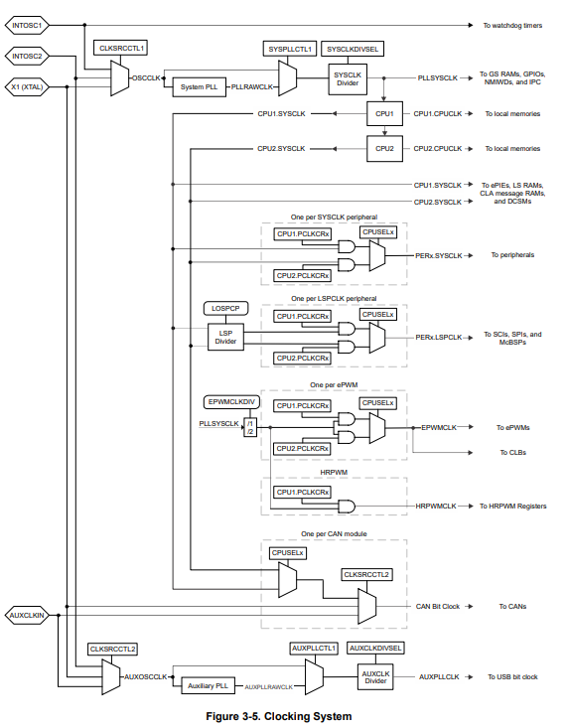
Clock Source for the timers (2/2)
Timer2: normally runs off of:
SYSCLK
INTOSC1,
INTOSC2,
XTAL,
and AUXPLLCLK.
Note: USB Auxiliary Clock (AUXPLLCLK) The USB module requires a fixed 60-MHz clock for bit sampling. Since the main system clock is usually not a multiple of 60 MHz, the correct frequency cannot be achieved with a simple divider. Instead, the USB clock is provided through an auxiliary clock path (AUXPLLCLK), which can use an independent clock source and PLL to generate the correct frequency.

Slide 14
Introduction to the Timer Control Register (TCR)
In addition to the period, counter, and prescale registers, the Timer Control Register (TCR) manages how the CPU timer operates — controlling start/stop, reload, and interrupt functions.
TIM CPU-Timer: Counter Register.
PRD CPU-Timer: Period Register.
TPR CPU-Timer: Prescale Register.
TPRH CPU-Timer: Prescale Register High.
TCR CPU-Timer: Timer Control Register.

Slide 15
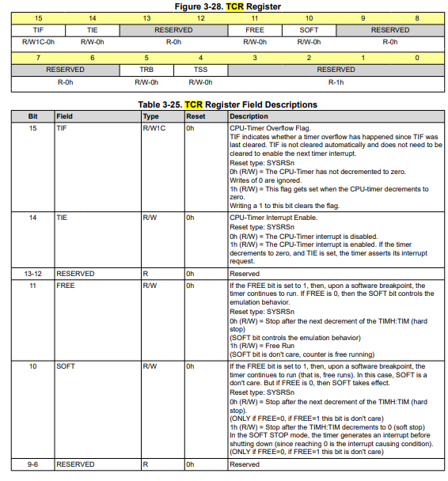
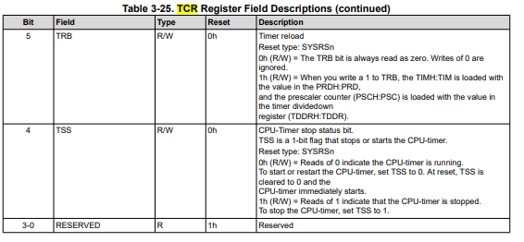
Timer Control Register (TCR) 1/2
TCR bit fields:
TIF: Timer Interrupt Flag.
TIE: Timer Interrupt Enable.
FREE: Free-Run During Debug.
SOFT: Soft Stop Control.
TRB: Timer Reload.
TSS: Timer Stop Status.

Slide 16
Timer Control Register (TCR) 2/2
Bit | Field | Type | Description (simplified)
15 | TIF (Timer Interrupt Flag) | R/W/1C | Set when the timer counter reaches zero. Must be cleared by writing 1 to acknowledge the interrupt.
14 | TIE (Timer Interrupt Enable) | R/W | Enables interrupt generation. When 1, an interrupt occurs when TIF = 1.
13–12 | — | — | Reserved.
11 | FREE | R/W | Defines behavior during emulation: • 1: Timer runs free during debug. • 0: Timer halts when CPU is halted.
10 | SOFT | R/W | Controls stop behavior: • 1: Stop after reaching zero (soft stop). • 0: Immediate stop (hard stop).
9–6 | — | — | Reserved.
5 | TRB (Timer Reload Bit) | R/W | Writing 1 reloads the timer counter from the period register (PRDH:PRD).
4 | TSS (Timer Stop Status) | R/W | Controls start/stop: • 1: Timer stopped. • 0: Timer running.
3–0 | — | — | Reserved.
The FREE and SOFT bits mainly affect debug and emulation behavior.

Slide 17
Illustrate basic timer polling and introduce bit control logic in TCR
Example – Basic Timer Operation (Polling Mode)
Objective:
Configure CPU Timer 0 to run continuously and perform an action every time it overflows.
CpuTimer0Regs.PRD.all = 0xFFFFFFFF;
CpuTimer0Regs.TPR.all = 0;
CpuTimer0Regs.TCR.bit.TSS = 0;
while(1) {
if (CpuTimer0Regs.TCR.bit.TIF == 1) {
CpuTimer0Regs.TCR.bit.TIF = 1;
// Timer actions
}
}
Explanation
PRD: Sets the timer period (here max = 0xFFFFFFFF).
TPR: Prescaler = 0 → timer counts every CPU cycle.
TSS = 0: Starts the timer.
TIF: Set when the timer reaches zero → must be cleared manually.

Slide 18
Polling Mode vs Interrupt Mode
Polling Mode (your current example)
The CPU continuously checks (polls) the timer flag TIF inside a while(1) loop.
When TIF == 1, it means the timer has reached zero.The flag must then be cleared manually (TIF = 1) before continuing.
No interrupt vector or ISR is involved — the CPU stays busy checking the flag.
Simpler to understand.
CPU inefficient: wastes time in the loop instead of doing other tasks.
Interrupt Mode (recommended for most applications)
The timer is configured to generate an interrupt automatically when it reaches zero.
TIE = 1 (Timer Interrupt Enable bit) allows the timer to trigger the interrupt.
The CPU jumps to a predefined Interrupt Service Routine (ISR) to handle the event.
No need to poll TIF in software: it’s cleared in the ISR.
CPU efficient: runs other code until the interrupt occurs.
Slightly more complex setup: needs PIE, interrupt vector, and enabling global interrupts.

Slide 19
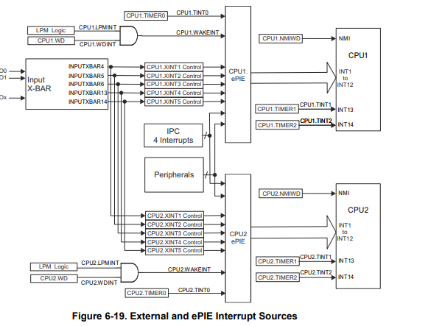
Timer Interrupts
TINT0 → goes through the PIE (Peripheral Interrupt Expansion) block (INT1.7).
TINT1 → connected directly to CPU interrupt INT13.
TINT2 → connected directly to CPU interrupt INT14.
These interrupts allow the CPU to automatically respond to timer events without continuously polling the flag.
In this chapter, we focused on polling mode;
in the next chapter, we will see how to configure and use timer interrupts through the PIE and CPU interrupt system.
Ref: TMS320F2837xD Dual-Core Real-Time Microcontrollers

Slide 20
Can the timer TINT of the timer be routed to a GPIO for the c28379d?

Slide 21
Can the timer TINT of the timer be routed to a GPIO for the c28379d?
No, the timer interrupt (TINT) of the CPU timers (Timer0, Timer1, Timer2) on the TMS320F28379D cannot be directly routed to a GPIO pin.
The CPU timer interrupts (TINT0, TINT1, TINT2) are primarily used to signal the CPU when the timer period expires, allowing the execution of an interrupt service routine (ISR). These interrupts are handled internally by the interrupt system in the CPU, and there is no direct hardware mechanism to route these timer interrupts to a GPIO pin.
However, timer interrupts are also used to signal peripherals within the system. For example, a timer interrupt can trigger actions in other peripherals such as triggering an ADC conversion or a PWM reload event. This allows peripherals to synchronize their operations with the CPU timer.
If you need to output a signal related to a timer event to a GPIO, you can manually toggle a GPIO pin in the Timer ISR to simulate such a behavior.
For example:
In the TINT ISR, you can set or clear a GPIO pin to indicate that the timer event has occurred.
The GPIO toggling must be done in the software within the ISR handling the TINT.

Slide 22
Can the timer TINT of the timer be routed to a GPIO for the c28379d?
Here’s a simple example of toggling a GPIO in the Timer ISR:
__interrupt void cpuTimer0ISR(void)
{
// Increment the timer interrupt count
cpuTimer0IntCount++;
// Toggle GPIO pin (e.g., GPIO0)
GPIO_togglePin(0);
// Acknowledge the interrupt to receive more timer interrupts
Interrupt_clearACKGroup(INTERRUPT_ACK_GROUP1);
}
Interrupts will be introduced in the next lecture.

Slide 23
List of the main methods used to configure peripheral registers on the C2000
(like CPU Timers, ePWMs, ADCs, etc.):
Bit-Field Access
Used to modify or read a specific bit or field inside a register.
Example:
CpuTimer0Regs.TCR.bit.TSS = 0; // Start the timer
CpuTimer0Regs.TCR.bit.TIE = 1; // Enable interrupt
Easy to read and precise for single-bit control.
Slightly slower and generates more code.

Slide 24
List of the main methods used to configure peripheral registers on the C2000
(like CPU Timers, ePWMs, ADCs, etc.):
2. Whole Register Access (.all)
Used to write or read the entire 16- or 32-bit register at once.
Example:
CpuTimer0Regs.TCR.all = 0x4000; // Set entire register value
CpuTimer0Regs.PRD.all = 0xFFFFFFFF;
Efficient, writes the whole register in one instruction.
Less readable and risky — may overwrite unintended bits.

Slide 25
List of the main methods used to configure peripheral registers on the C2000
(like CPU Timers, ePWMs, ADCs, etc.):
3. Grouped or Structured Access (1/4)
Many peripherals have structured registers (e.g., EPwm1Regs.TBCTL.bit.CLKDIV).
You can access them hierarchically by module name, register and field.
Example:
EPwm1Regs.TBCTL.bit.CTRMODE = 2; // Set count-up mode
EPwm1Regs.CMPA.bit.CMPA = 1500; // Set compare value

Slide 26
List of the main methods used to configure peripheral registers on the C2000
(like CPU Timers, ePWMs, ADCs, etc.):
3. Grouped or Structured Access (2/4)
Pros
Readable & explicit: Clear intent at the field level (.bit.CTRMODE = 2).
Discoverable: Great with IDE autocompletion; you see valid fields and docs.
Type-safe-ish: Uses TI’s register structs; fewer typos vs. raw addresses.
Low risk of clobbering: You change only the targeted bit/field.
Notes:
Clobbering: In programming, clobbering means overwriting a variable, memory location, or register’s value unintentionally — usually destroying data that another part of the program still needs.

Slide 27
List of the main methods used to configure peripheral registers on the C2000
(like CPU Timers, ePWMs, ADCs, etc.):
3. Grouped or Structured Access (3/4)
RMW overhead: Often compiles to read-modify-write; slightly larger/slower than a single .all write.
Performance-sensitive paths: Not ideal when you must flip many bits atomically.
Portability locked to headers: Tied to TI’s struct definitions/version.
Shadow/commit gotchas: Some peripherals (ePWM, ADC SOCs) need specific write sequences, field writes don’t hide that.
Hidden side effects: If hardware expects a “write 1 to clear” or requires ordering, you still need to handle it manually.

Slide 28
List of the main methods used to configure peripheral registers on the C2000
(like CPU Timers, ePWMs, ADCs, etc.):
3. Grouped or Structured Access (4/4)
Use it when:
Teaching/labs and most app code where clarity > raw speed.
Touching a few specific fields and you want to avoid accidental bit clobbering.
Avoid it when:
You must set many bits at once (use .all + masks or DriverLib).
The register requires atomic updates or strict shadow/commit timing.

Slide 29
List of the main methods used to configure peripheral registers on the C2000
(like CPU Timers, ePWMs, ADCs, etc.):
4. Macro-Based Register Access
TI libraries (like DriverLib) provide macros or functions to configure registers safely.
Example (DriverLib style):
CPUTimer_setPeriod(CPUTIMER0_BASE, 0xFFFFFFFF);
CPUTimer_setPreScaler(CPUTIMER0_BASE, 0);
CPUTimer_startTimer(CPUTIMER0_BASE);
Portable, safer, and cleaner.
Slightly more abstract — hides low-level detail.

Slide 30
List of the main methods used to configure peripheral registers on the C2000
(like CPU Timers, ePWMs, ADCs, etc.):
5. Direct Memory Access (Pointer Method)
Advanced users can directly manipulate registers via their memory-mapped addresses.
Example:
*(volatile Uint16*)0x00000C00 = 0x0001;
Ultimate control (rarely needed).
Dangerous — bypasses register definitions and type safety.

Slide 31
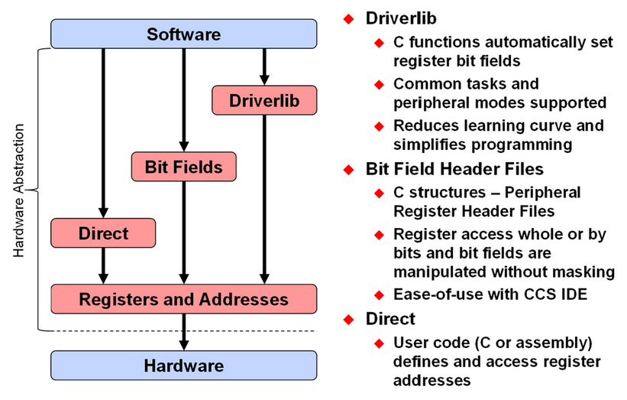
Drivers
https://software-dl.ti.com/C2000/docs/software_guide/c2000ware/drivers.html#:~:text=The%20C2000%20Peripheral%20Driver%20Library,extern%20function%20prototypes

Slide 32
Lab debrief
What is the difference between these two instructions:
CPUTimer_enableInterrupt(CPUTIMER0_BASE);
Interrupt_enable(INT_TIMER0);

Slide 33
Lab debrief
What is the difference between these two instructions:
1. CPUTimer_enableInterrupt(CPUTIMER0_BASE);
2. Interrupt_enable(INT_TIMER0);
Instruction | Level | What it does | Without it
1 | Peripheral level | Enables the CPU Timer 0 peripheral to generate an interrupt signal when it reaches zero (sets the TIE bit in its control register). | The timer will count, but no interrupt signal is sent.
2 | CPU interrupt controller (PIE/CPU level) | Enables the CPU core to accept and respond to the interrupt request from Timer 0. | The timer asserts an interrupt, but the CPU ignores it

